Slide 1
Introduction to multivariate state-space models
Eli Holmes
FISH 550 – Applied Time Series Analysis
17 April 2025

Slide 2
Gaussian state-space models
5 lecture block on Gaussian state-space models.
Lectures 1 & 2: building blocks for analysis of multivariate time-series data with observation error, structure, and missing values
Lectures 3-5: Specific applications: covariates, dynamic factor analysis, dynamic linear models

Slide 3
Topics
Examples of multivariate structure in population data
How to express these structures mathematically
Adding a multivariate observation process
Overview of the MARSS package and syntax

Slide 4
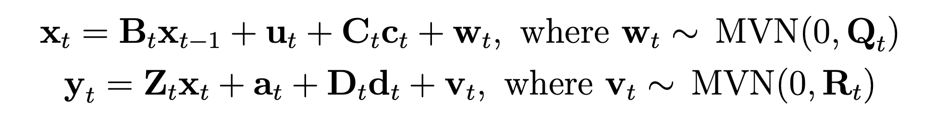
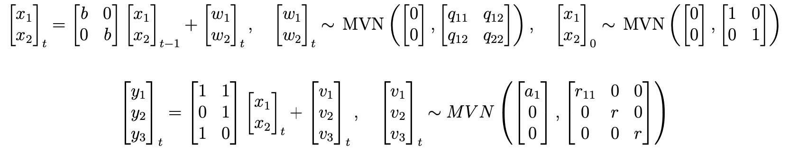
Gaussian state-space models

Slide 5
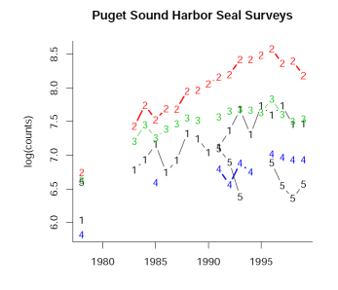
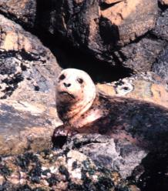
Chapter 7 in HWS 2014
Chapter 7: Combining multi-site data to estimate regional population trends

Slide 6
Imagine we have 3 sampling locations for a population and we measure it 20 years
Location 1
mark-recapture
Location 3
line transect
Location 2
mark-recapture

Slide 7
Mathematically we can write
Exponential population growth in log space
Random walk with drift
Log population size
Mean bias
Observations
noise

Slide 8
The observation part can be rewritten
We need to fix one of the a’s.
Traditionally we fix to the first to 0.
population size
observations
Z matrix
bias
noise

Slide 9
The model with one a fixed to zero
Z matrix
Log population size
bias
noise
observations

Slide 10
The observation errors are multivariate. For now, let’s assume Normality
The variance-covariance matrix tells you how the observation errors are related. Are they independent? Or do they covary? Do they have the same variance or difference variances?

Slide 11
Example observation error variance-covariance matrices
This case is really hard to estimate. Figure out how to change your sampling.
unconstrained
“equal varcov”
diagonal
unique variances and uncorrelated errors
identical variances and uncorrelated errors

Slide 12
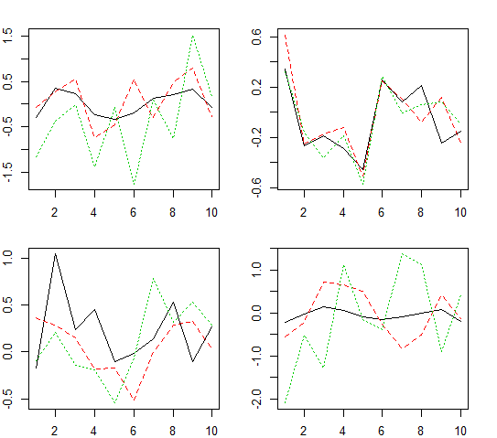
Example of errors coming from these variance-covariance matrices
unconstrained
equal var-cov
error
= how much the error is above or below average
diagonal and equal
diagonal and unequal
mvrnorm(10,rep(0,3),diag(.1,3))

Slide 13
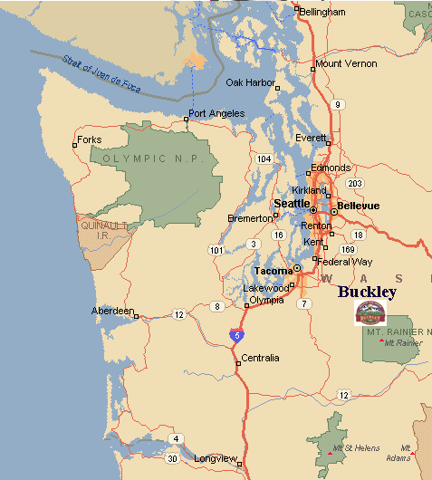
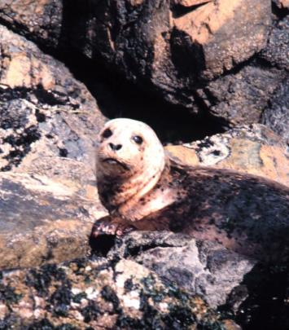
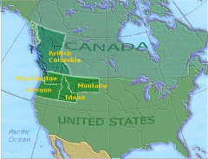
An example: modeling the population dynamics of harbor seals in Puget Sound, WA

Slide 14
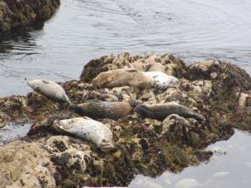
Multi-site data (Pacific harbor seals)
Jeffries et al. 2003. Trends and Status of Harbor Seals in WA State: 1978-1999. J of Wildlife Management 67: 208-219.

Slide 15

Let’s hypothesize (and model) that the population has 3 subpopulations
JF
North
Strait of JF
N
log population size (x)
South
S
Three subpopulations that are independent but have correlated population dynamics (dispersal, similar environment, etc.)
year

Slide 16
A multivariate model for the population (not the observations but the actual population)
Multivariate stochastic exponential growth
Log population size
3 different process errors
e ~ MVN(0,Q)
3 mean population growth rate terms
3 different x’s, one for each subpopulation

Slide 17
The population model in matrix form
Exponential population growth with drift (tendency to increase or decline)
x_{t} = x_{t-1} + u + w_{t}
w_{t} ~ MVN(0,Q)
Each parameter has “structure”. Different structures imply different population structure.

Slide 18
The mean population growth rates (u) can have spatial structure
unconstrained (all different)
all the same
Strait of Juan de Fuca different
North and South same

Slide 19
The process error var-cov matrix can have structure: w_{t} ~MVN(0,Q)
unconstrained
variances all different and year-to-year population changes covary
diagonal
unique variances and year-to-year population changes are uncorrelated
diagonal
same variances and year-to-year population changes are uncorrelated
JF has unique variance;
N & S share the same variance
yr-to-yr changes have equal covariance

Slide 20
x_{t} = x_{t-1} + u + w_{t}
JF
North
Strait of JF
N
South
S
The structure of the u and Q specify our hypotheses (or assumptions) about how the environment is shared.

Slide 21
We observe our subpopulations and those observations have error
For example, some surveys are from boats. Counting is not perfect and some animals are in the water.
NEFSC/NOAA

Slide 22
The obs. err. model specifies how the observed time series are related to the true subpopulation sizes
1
2
3
5 sampling locations
North
Strait of JF
4
5
South
Jeffries et al. 2003. TRENDS AND STATUS OF HARBOR SEALS IN WASHINGTON STATE: 1978–1999. J. Wildl. Manage. 67(1):208-219
Notes:
Add the subpopulation and remind that we suppose there are 3

Slide 23
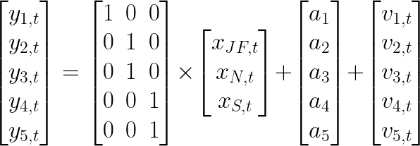
The observation model
true population “hidden”
JF N S
Log of counts
Z matrix
relates each observation time series to a different state process
measurement errors
observations
observation biases
Notes:
Color coding; remind that these are logged data; next slide different structures…. Z matrices with different structures

Slide 24
The observation errors have a var-cov matrix
unconstrained
unique variances and uncorrelated errors
identical variances and uncorrelated errors
diagonal
diagonal
Notes:
Show where R comes from; different structures; 5x5

Slide 25
The harbor seal multivariate state-space model in matrix form
identity
3x1 vectors
3x3 matrix
5x5 matrix
5x1 vectors

Slide 26
Instead of N, S, Str. J subpopulations, we could have other combinations of subpopulations
Z matrix
Str. JF
San Isl.
E. Bays
P.S.
Hood C.
relates each observation time series to a different state process
Str of Juan de Fuca & San Juan Is sites = 1st subpop
Eastern bays = 2nd
Hood C. & S. Puget S. = 3rd
Strait of Juan de Fuca =
1st sub pop
San Juan Is sites = 2nd
Eastern bays, Hood Canal & S. Puget Sound = 3rd
One Puget Sound population and all sites are sampling it
One population
Notes:
\

Slide 27
The same model can capture many different underlying population structures and observation structures

Slide 28
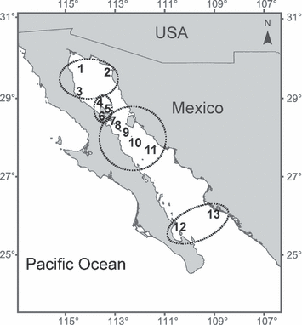
Inferring spatial structure from time‐series data: using multivariate state‐space models to detect metapopulation structure of California sea lions in the Gulf of California, Mexico
(NOAA, Channel Is)
Hypotheses about the population structure:
Diet, Disease, DNA, Distance
(2 null models: no structure and fully structured)
Journal of Applied Ecology Volume 47, Issue 1, pages 47-56, 15 DEC 2009 DOI: 10.1111/j.1365-2664.2009.01745.x http://onlinelibrary.wiley.com/doi/10.1111/j.1365-2664.2009.01745.x/full#f1
Notes:
Map of the Gulf of California, Mexico. The numbered sites correspond to: (1) Rocas Consag; (2) San Jorge; (3) Los Lobos; (4) Granito; (5) Los Cantiles; (6) Los Machos; (7) El Partido; (8) Rasito; (9) San Esteban; (10) San Pedro Martir; (11) San Pedro Nolasco; (12) Los Islotes; (13) Farallon de San Ignacio. Circles show the four subpopulations selected by the best‐fit model (Table 1).
© IF THIS IMAGE HAS BEEN PROVIDED BY OR IS OWNED BY A THIRD PARTY, AS INDICATED IN THE CAPTION LINE, THEN FURTHER PERMISSION MAY BE NEEDED BEFORE ANY FURTHER USE. PLEASE CONTACT WILEY'S PERMISSIONS DEPARTMENT ON PERMISSIONS@WILEY.COM OR USE THE RIGHTSLINK SERVICE BY CLICKING ON THE 'REQUEST PERMISSION' LINK ACCOMPANYING THIS ARTICLE. WILEY OR AUTHOR OWNED IMAGES MAY BE USED FOR NON-COMMERCIAL PURPOSES, SUBJECT TO PROPER CITATION OF THE ARTICLE, AUTHOR, AND PUBLISHER.

Slide 29
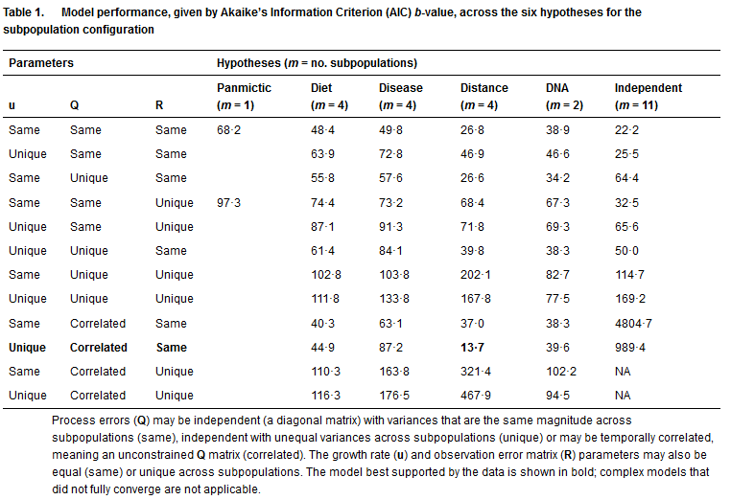

Slide 30

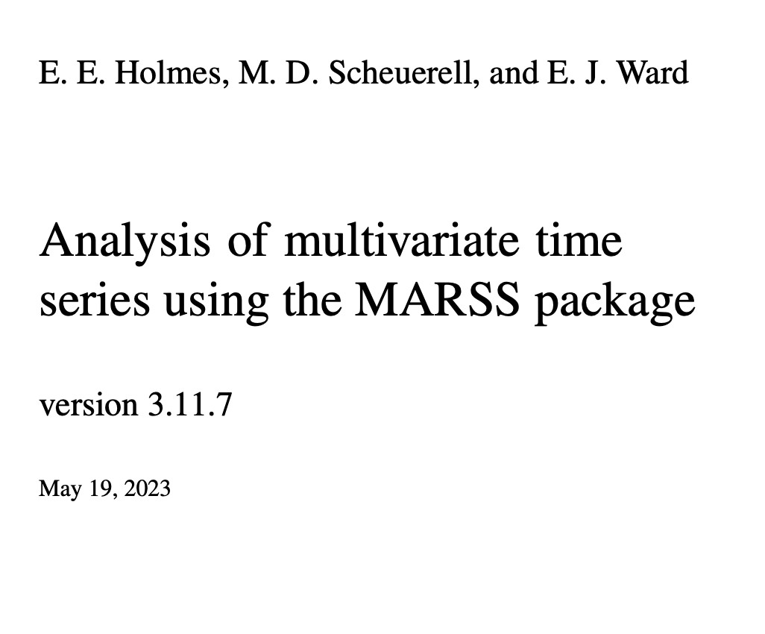
https://atsa-es.github.io/atsa-labs/
MARSS User Guide

Slide 31
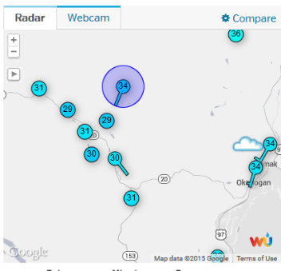

Other examples
Combine multiple station data into a single metric
Multiple individual growth rates measured over time

Slide 32
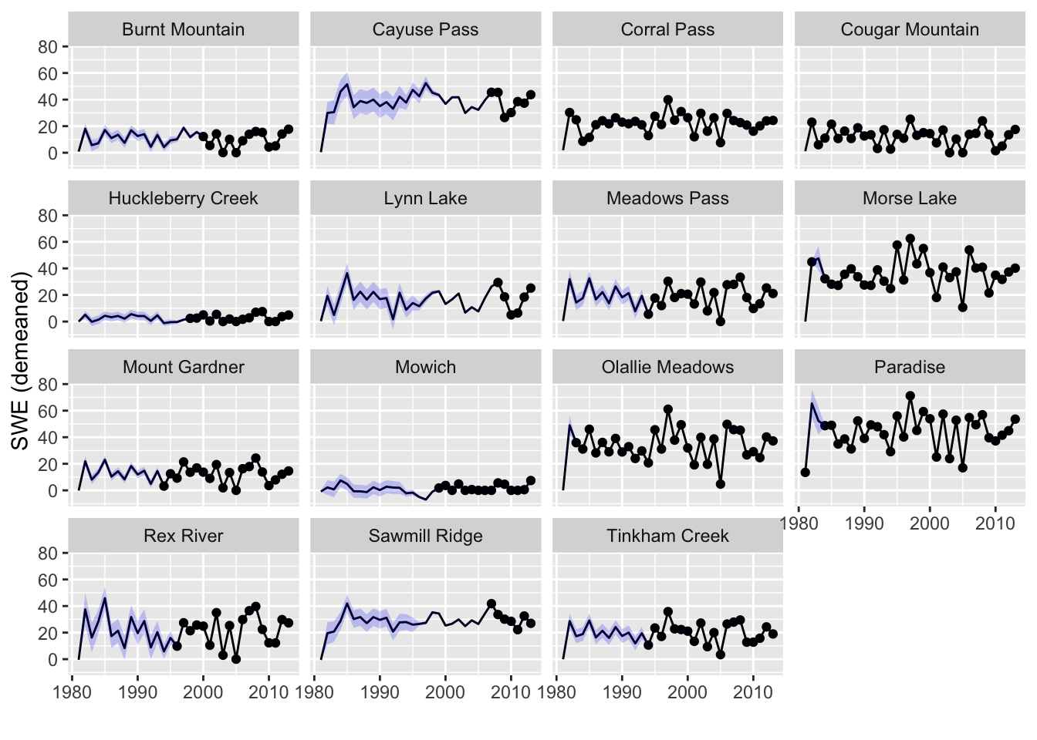
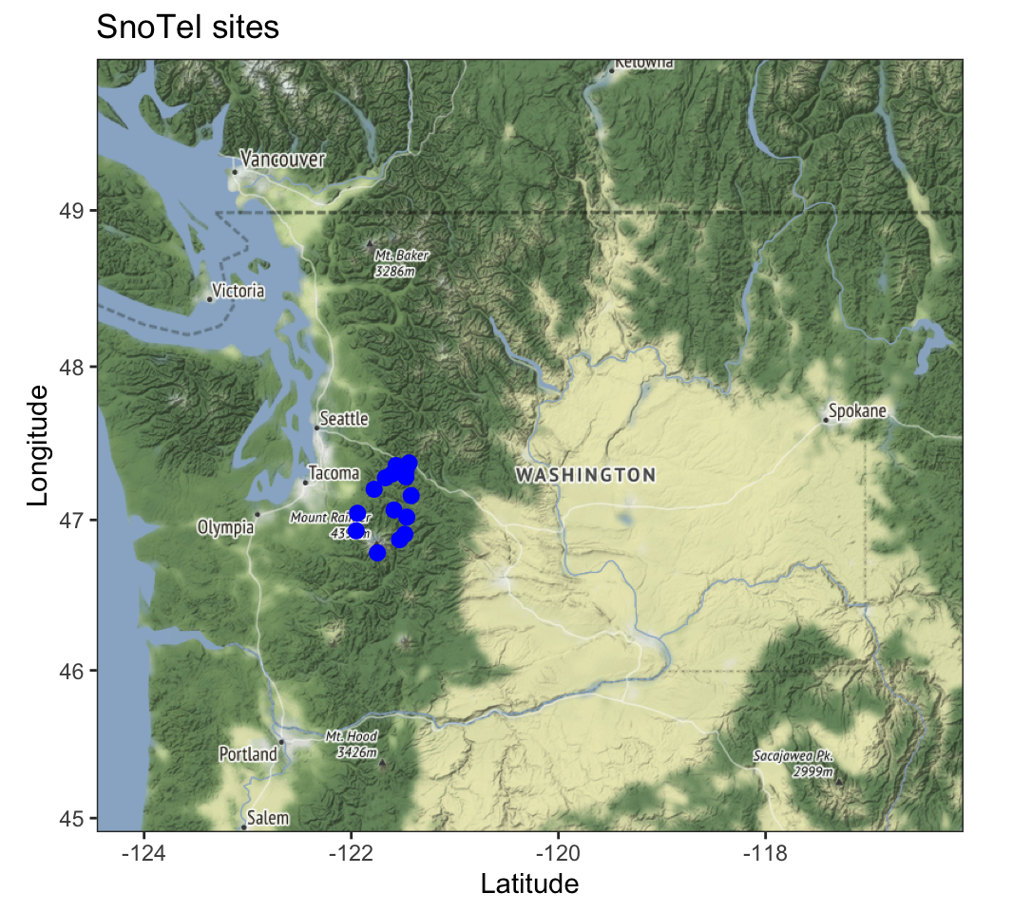
Estimating missing values

Slide 33
Fitting MARSS models using the MARSS R Package https://cran.r-project.org/web/packages/MARSS/index.html
Fits MARSS models
Model specification is 1-to-1 with the equation for the model
General, fits any MARSS model with Gaussian errors.
BUT
Maximum likelihood
Slow for large data sets. Huge speed improvements are possible using TMB
marssTMB: https://atsa-es.github.io/marssTMB/

Slide 34
MARSS R Package Model Syntax
X(t) = B X(t-1) + U + w(t), w(t) ~ N(0, Q)
Y(t) = Z X(t) + A + v(t), v(t) ~ N(0,R)
fit2=MARSS(y,model=mod.list)
y is data; model tells MARSS what the parameters are
The parameters are MATRICES
You write matrices just like they appear in your model on paper. Matrices must be MATRICES (not scalars, not vectors)
You pass model to MARSS as a list

Slide 35
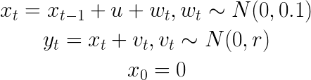
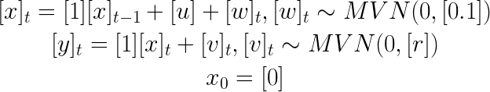
X(t) = B X(t-1) + U + w(t), w(t) ~ N(0, Q)
Y(t) = Z X(t) + A + v(t), v(t) ~ N(0,R)
mod.list=list(
U=matrix(“u"),
x0=matrix(0),
B=matrix(1),
Q=matrix(0.1),
Z=matrix(1),
A=matrix(0),
R=matrix("r"),
tinitx=0)
Let’s say we want to fit this model:
Write in matrix form:
mod.list=list(
Q=matrix(0.1)
)

Slide 36
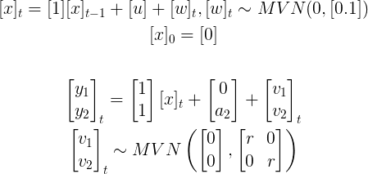
X(t) = B X(t-1) + U + w(t), w(t) ~ N(0, Q)
Y(t) = Z X(t) + A + v(t), v(t) ~ N(0,R)
mod.list=list(
U=matrix(“u"),
x0=matrix(0),
B=matrix(1),
Q=matrix(0.1),
Z=matrix(1,2,1),
A= matrix(list(0,"a2"),2,1),
R= matrix(list("r",0,0,"r"),
tinitx=0)
Let’s say we want to fit a model where two sites are sampling temperature x in a lake:
Our temperature model:
Our two temperature sensors:

Slide 37
Some short examples
marss_example_1.R
marss_example_2.R
marss_example_3.R

Slide 38
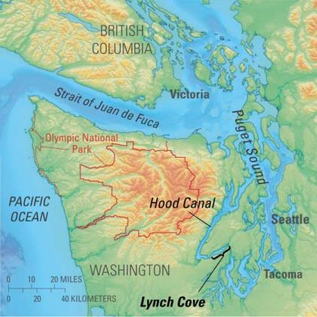
The MARSS manual has two chapters using MARSS models to analyze spatial count data
harbor seal count data from the west coast of the USA

Slide 39
Chapter 8 in HWS 2014
Combining multi-site data to estimate regional population trends

Slide 40
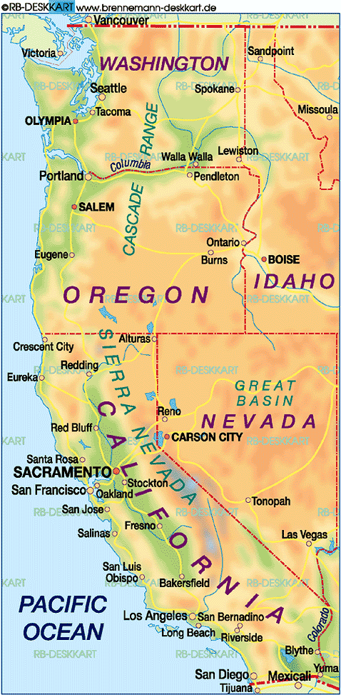
Chapter 9 in HWS 2014
Identifying spatial structure and covariance in harbor seals on the west coast of the USA
2000km

Slide 41
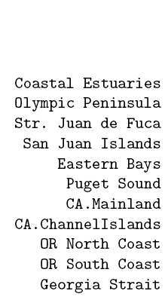
Shortcut for the Z matrix
count =
+ a + v
Z matrix
factor(c(“or.wa”,”or.wa,”ps”,”ps”,”ps”,”ps”,”ca”,”ca”,”or.wa”,”or.wa”,”ps”))

